Slide 1
Dcs world mission Development with moose

Slide 2
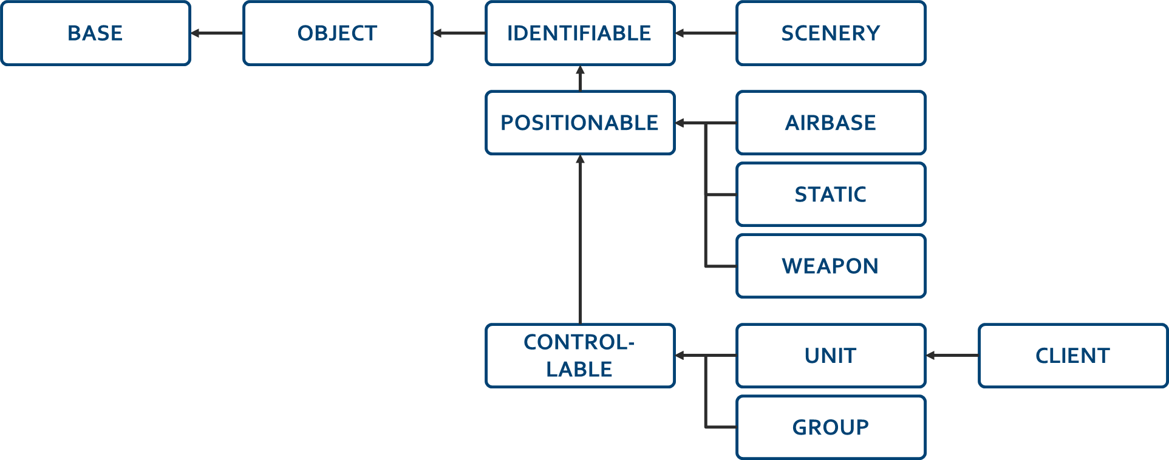
moose wrapper CLASSes
MOOSE provides an abstraction of the DCS object model with a new class hierarchy

Slide 3
the core wrapper classes in moose
BASE
OBJECT
IDENTIFIABLE
SCENERY
POSITIONABLE
AIRBASE
STATIC
WEAPON
CONTROL-LABLE
UNIT
CLIENT
GROUP

Slide 4
WRAP-UP

Slide 5
consult the online documentation
All class and API descriptions on the MOOSE GITHUB pages.
There are online training videos available on my YOUTUBE CHANNEL.
The documentation explains:
How to use MOOSE and install it in your mission.
The directory structure of the MOOSE pack.
Classes are embedded in lua “modules”. Eg. the zone classes are collected in the lua module Zone.
A CLASS in the lua documentation is sometimes referenced by Module#CLASS.
The Module is sometimes not given, so #CLASS references to a class within the current module. All these references are clickable, so within the documentation, it is possible to move back and forth through the explanations.

Slide 6
Training missions
Each of the classes have Example Test Missions!
Find in the MOOSE pack or on GITHUB the relevant directories:
Moose_Test_PATROLZONE
Moose_Test_AIBALANCER
Each of these directories contain:
A DCS World .MIZ file containing an executable mission.
The .LUA file containing the example code using the zone class (and other classes).

Slide 7
HOPE YOU FOUND THIS INTERESTING
You can reach me on SKYPE with the ID: FlightControl_Skype
Or, join the SLACK.COM development community at
https://flightcontrol.slack.com/messages/moose/

